Slide 1
Digital portfolio
STUDENT NAME : SARANYA D
REGISTER NO : 2426J0367
NM ID : 871E3694EE6BAF38B4744F92DFDCCBCC
DEPARTMENT : COMPUTER SCIENCE
COLLEGE NAME : NAVARASAM ARTS AND SCIENCE COLLEGE
FOR WOMEN , BHARATHIYAR UNIVERSITY

Slide 2
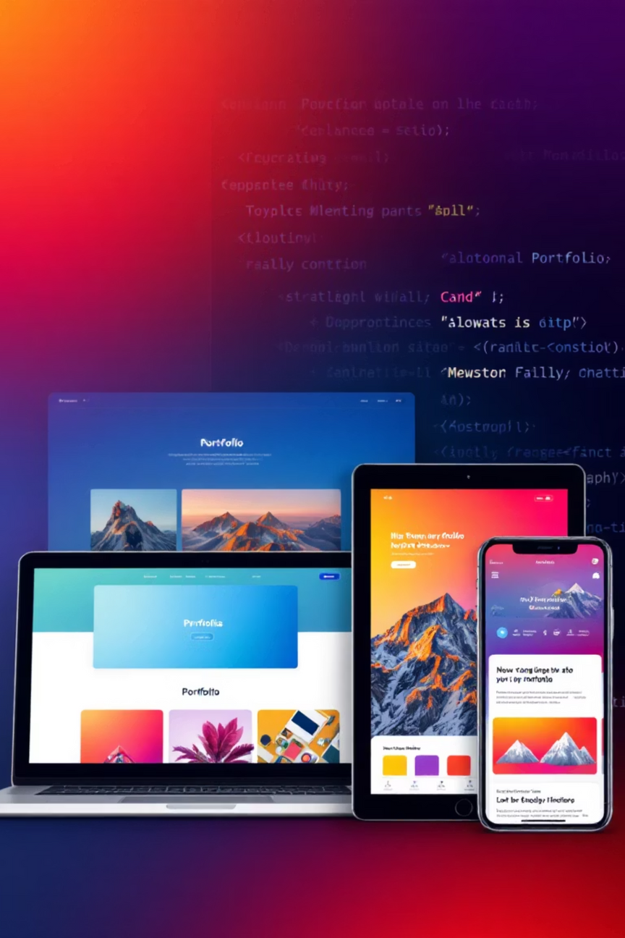

Interactive Front-End Portfolio: Showcasing Web Development Skills
A presentation on building a dynamic portfolio to highlight your web development prowess.
Notes:
1.7.2013
1
‹#›

Slide 3
Agenda
1.Problem Statement
2.Project Overview
3.End Users
4.Tools And Technology
5.Portfolio design and layout
6.Features and Functionality
7.Results and Screenshots
8.Conclusion
9.Github link

Slide 4
PROBLEM STATEMENT
"In today's competitive tech industry, a static resume often falls short. Developers need a dynamic platform to truly showcase their skills, creativity, and problem-solving abilities."
1
2
3
Limited Resume Impact
Skill Demonstration Gap
Employer Expectations
Traditional resumes lack the visual and interactive depth to convey web development proficiency effectively.
It's challenging to prove front-end skills like responsiveness, interactivity, and UI/UX design without live examples.
Hiring managers increasingly expect tangible proof of work through engaging, functional portfolios.
Notes:
1.7.2013
2
‹#›

Slide 5
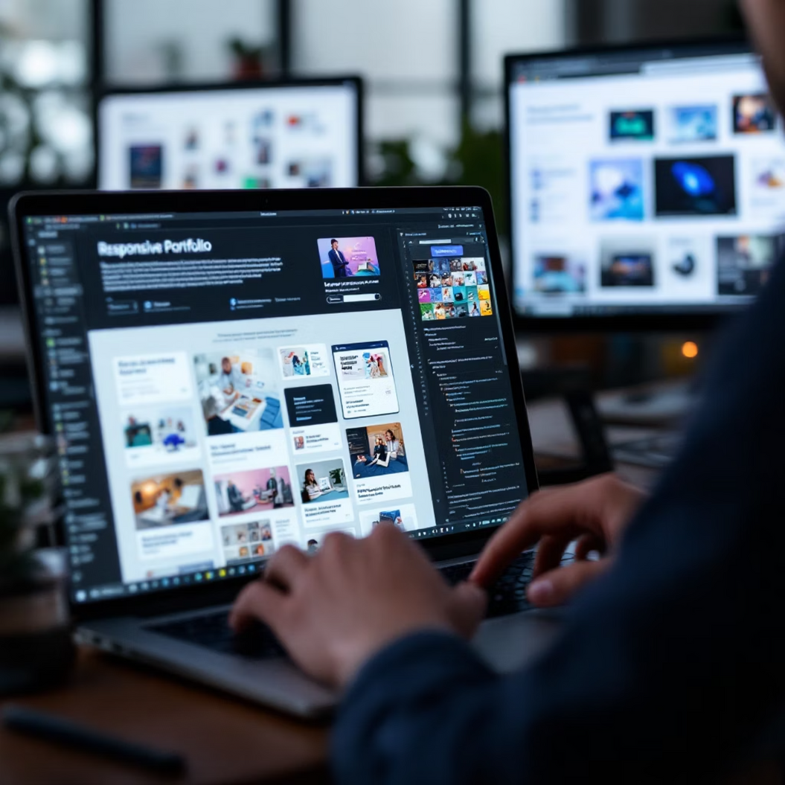
Project Overview
This project outlines the creation of an interactive front-end portfolio designed to effectively present web development capabilities. Our focus is on responsiveness across devices and engaging user experiences.
Goal: To create a comprehensive, visually appealing, and functional portfolio that stands out.
Responsive Design
Interactive Elements
Showcasing Projects
Ensuring seamless viewing across desktops, tablets, and mobile phones.
Incorporating animations, hover effects, and dynamic content to captivate visitors.
Dedicated sections for various web development projects with live demos and code links.
Notes:
1.7.2013
3
‹#›

Slide 6



End Users
Our portfolio is strategically designed to cater to diverse audiences, each with unique expectations and needs when evaluating a developer's profile.
Employers
Potential Clients
Fellow Developers
Seeking candidates with demonstrable skills, project execution capabilities, and a keen eye for UI/UX. They value clarity, professionalism, and quick access to live examples.
Looking for developers who can bring their visions to life. They appreciate clear communication, visual appeal, and examples relevant to their business needs.
Interested in code quality, implementation techniques, and innovative solutions. They might be looking for inspiration or collaboration opportunities.
Notes:
1.7.2013
4
‹#›

Slide 7
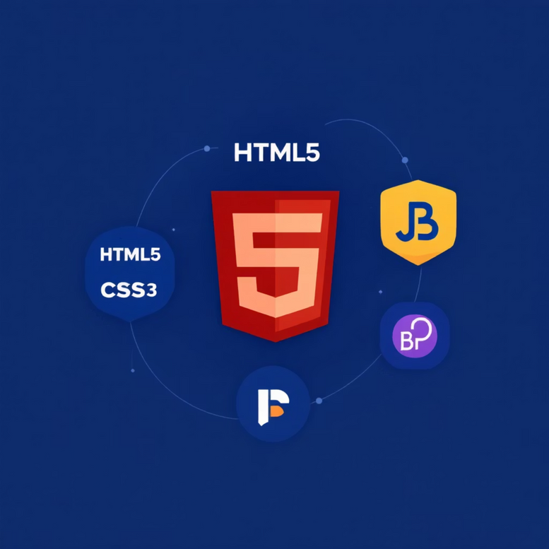
Tools and Technology
The portfolio's robust framework is built upon industry-standard front-end technologies, ensuring a modern, performant, and maintainable codebase.
HTML5: For semantic structuring and accessible content presentation.
CSS3: For modern styling, animations, and responsive design through media queries.
JavaScript: To implement interactive elements, dynamic content loading, and enhance user experience.
Bootstrap: A powerful front-end framework for rapid development of responsive, mobile-first websites.
CodePen: Utilised for embedding live code snippets and project demos directly into the portfolio, providing instant access to interactive examples without leaving the site.
Notes:
1.7.2013
5
‹#›

Slide 8




Portfolio Design and Layout
Our design philosophy centres on a clean, intuitive, and visually appealing interface that prioritises user experience (UX) while reflecting modern web aesthetics.
Clean & Minimalist
Intuitive Navigation
Uncluttered layout with ample whitespace to ensure focus on content and projects.
Clear, accessible navigation menus and calls-to-action guide users effortlessly through the site.
Consistent Branding
Mobile-First Approach
Harmonious colour palettes (using #1c9770ff, #93CB52, #7AD180, #7AD1C3), typography, and imagery create a cohesive professional identity.
Designed primarily for mobile responsiveness, ensuring optimal performance and usability on smaller screens.
Notes:
1.7.2013
6
‹#›

Slide 9
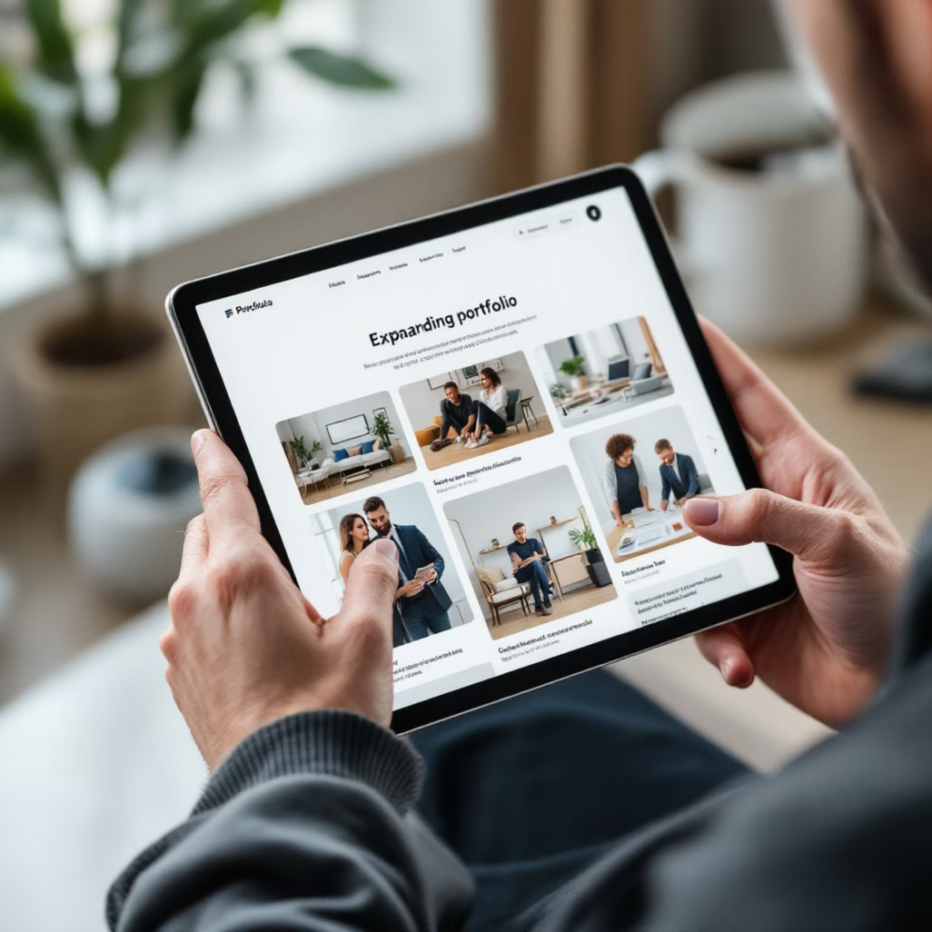
Features and Functionality
Beyond static information, the portfolio incorporates interactive elements and seamless navigation to engage visitors and provide a richer experience.
Dynamic Project Cards: Each project features interactive cards that expand on click to reveal more details, images, and embedded live demos.
Smooth Scrolling: Enhanced navigation with fluid scroll-to-section functionality for a polished user experience.
Contact Form with Validation: An easy-to-use contact form with real-time validation, ensuring reliable communication.
Responsive Image Galleries: Optimised image galleries that adapt to screen size, showcasing visual aspects of projects without performance compromise.
Notes:
1.7.2013
7
‹#›

Slide 10
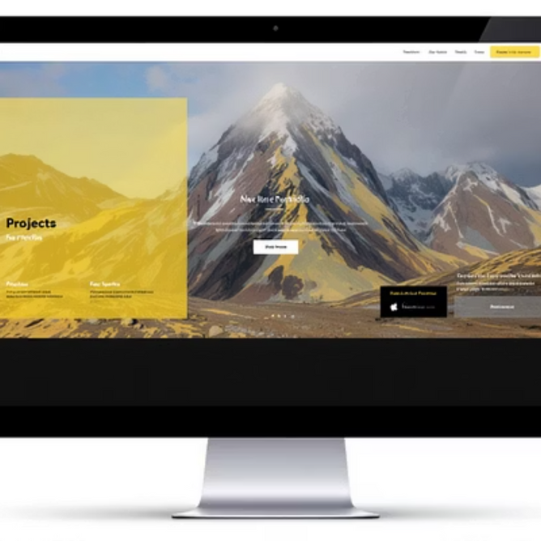
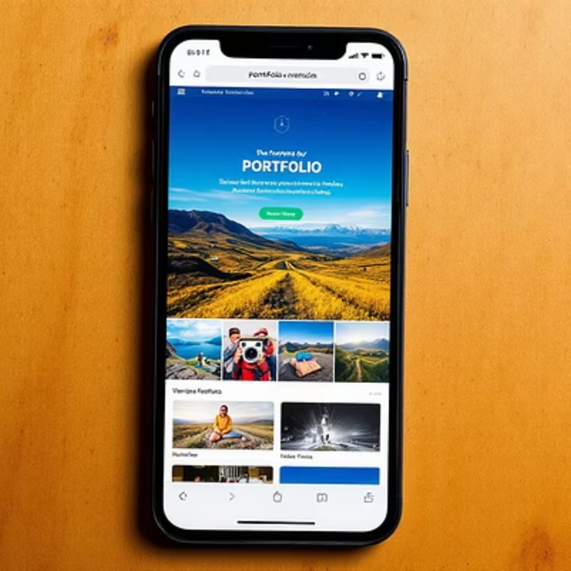

Results and Screenshots
The completed portfolio effectively showcases a range of front-end skills, providing tangible proof of concept through live, interactive components. These demonstrations highlight responsive design, dynamic content, and clean code.
For a live experience, please visit the portfolio here.
Notes:
1.7.2013
8
‹#›

Slide 11






Conclusion
A dynamic and interactive front-end portfolio is more than just a collection of projects; it is a powerful tool that significantly enhances career opportunities by providing a tangible, engaging representation of a developer's skills and potential.
Stronger Personal Brand
Establishes credibility and a professional identity within the developer community and beyond.
Enhanced Employability
Increases visibility and attractiveness to potential employers by directly demonstrating capabilities.
Continuous Learning
Encourages ongoing development and refinement of skills by consistently adding new projects.
Notes:
1.7.2013
9
‹#›

Slide 12


Github link
We invite you to explore the full codebase and provide feedback. The journey of skill enhancement is continuous, and this portfolio is a living testament to that.
Access the Codebase
The complete source code for this portfolio is openly available on GitHub. Feel free to review, fork, or contribute to the project.
Future enhancements will include integration with more advanced JavaScript frameworks, adding a blog section, and incorporating backend functionalities for a full-stack experience.
Notes:
1.7.2013
10
‹#›

